Slide 1

Data Science Capstone
Final Project: An analysis of the Food Venues in Toronto
Amy King-Robertson 4/20/2021

Slide 2

Introduction of the Business Problem
Goal is to provide venue information from the Foursquare location data tool to identify the most popular restaurants and their food types in Toronto.
Stakeholders:
Tourists, visitors, or individuals who are new to the city.
Individuals considering opening a new restaurant of a specific food venue category.

Slide 3
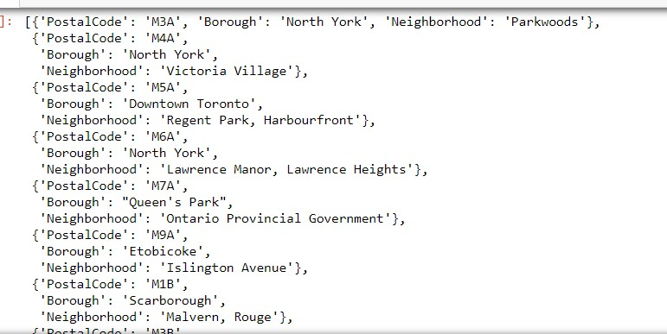
Data Description
Source 1: Json file data containing Toronto postal code data from the wikipedia website: https://en.wikipedia.org/wiki/List_of_postal_codes_of_Canada:_M.
Sample of json data provided in the figure.

Slide 4
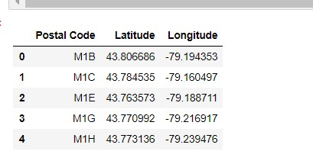
Data Description, cont.
Source 2: Data Science capstone course csv that was used in the Week 3 Assignment containing latitude and longitude for Toronoto postal codes. https://cf-courses-data.s3.us.cloud-object-storage.appdomain.cloud/IBMDeveloperSkillsNetwork-DS0701EN-SkillsNetwork/labs_v1/Geospatial_Coordinates.csv

Slide 5
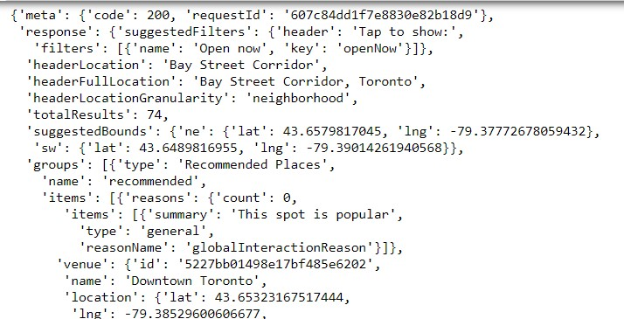
Data Description, cont.
Source 3: Venue information for each neighborhood obtained using the FourSquare application.
Information on FourSquare can be found here: https://foursquare.com/ or https://developer.foursquare.com/ for developer information.
Json file containing longitude and latitude

Slide 6
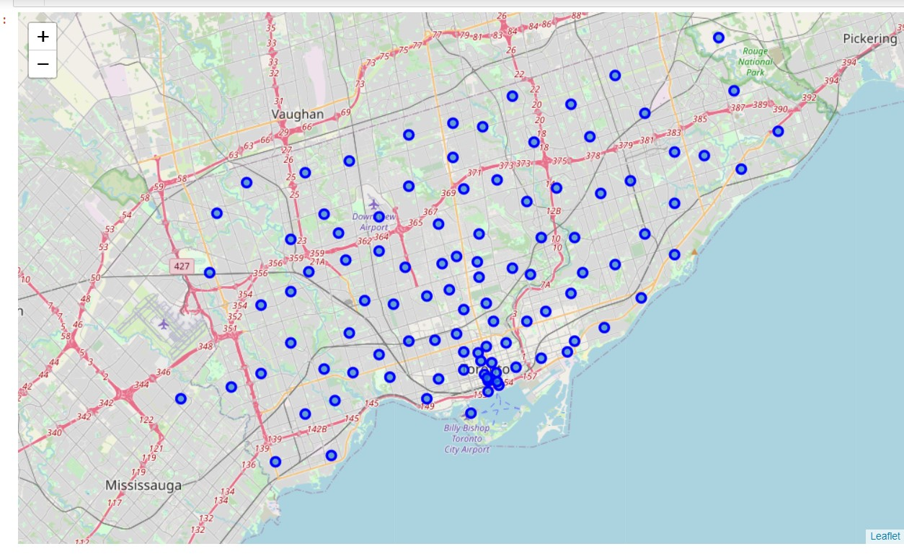
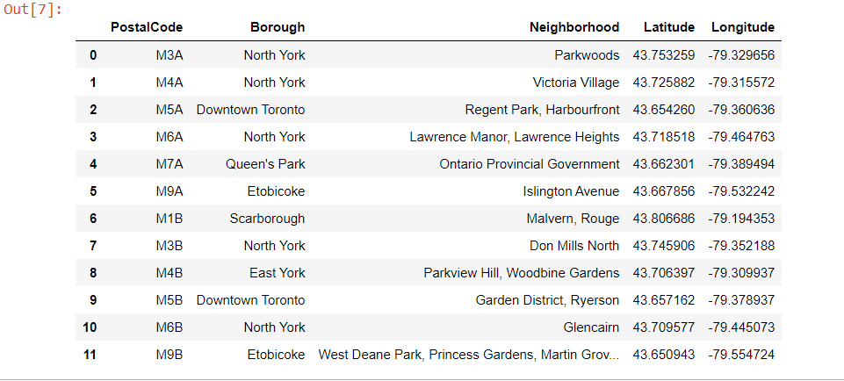
Methodology: Data Setup and Cleaning
Data sources one and two were merged to create one table containing postal code, Borough, neighborhood, and latitude/longitude. Sample of table on right.
Folium used to map the Boroughs in Toronto.

Slide 7
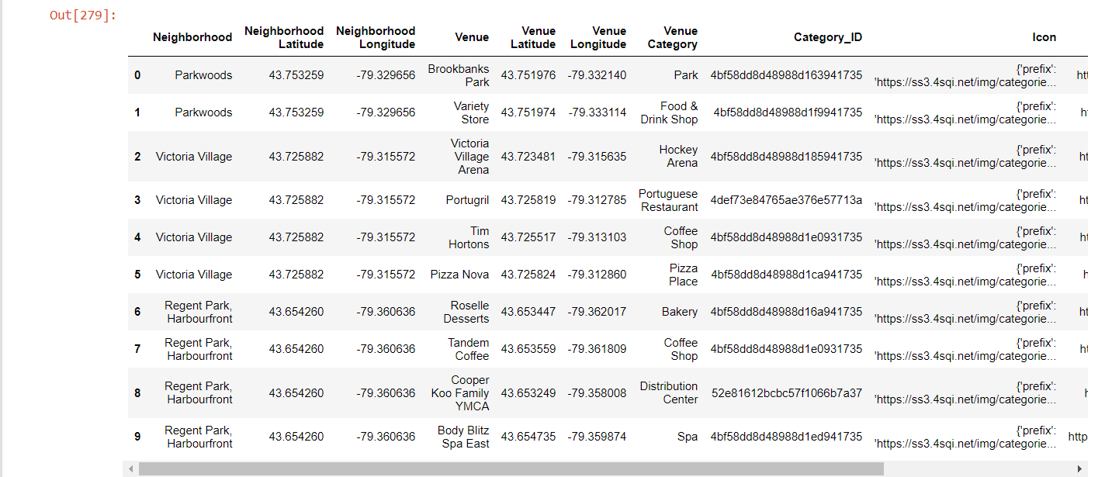
Methodology : Data Setup and Cleaning, cont.
FourSquare data used to pull all venues in Toronto based on longitude and latitude for CategoryID = 4d4b7105d754a06374d81259, identified in the FourSquare documentation as the category for Food.

Slide 8
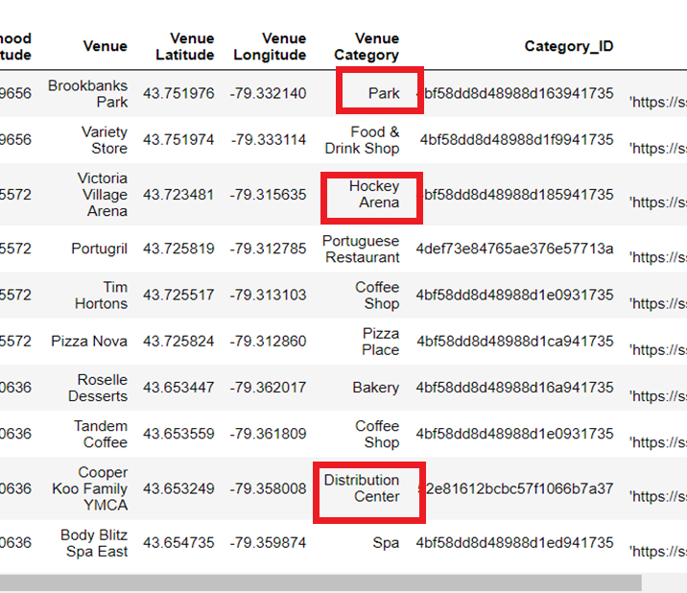
Methodology : Data Setup and Cleaning, cont.
Data Results returned included categories such as Park, Hockey Arena, Distribution Center, etc. that were not food.

Slide 9
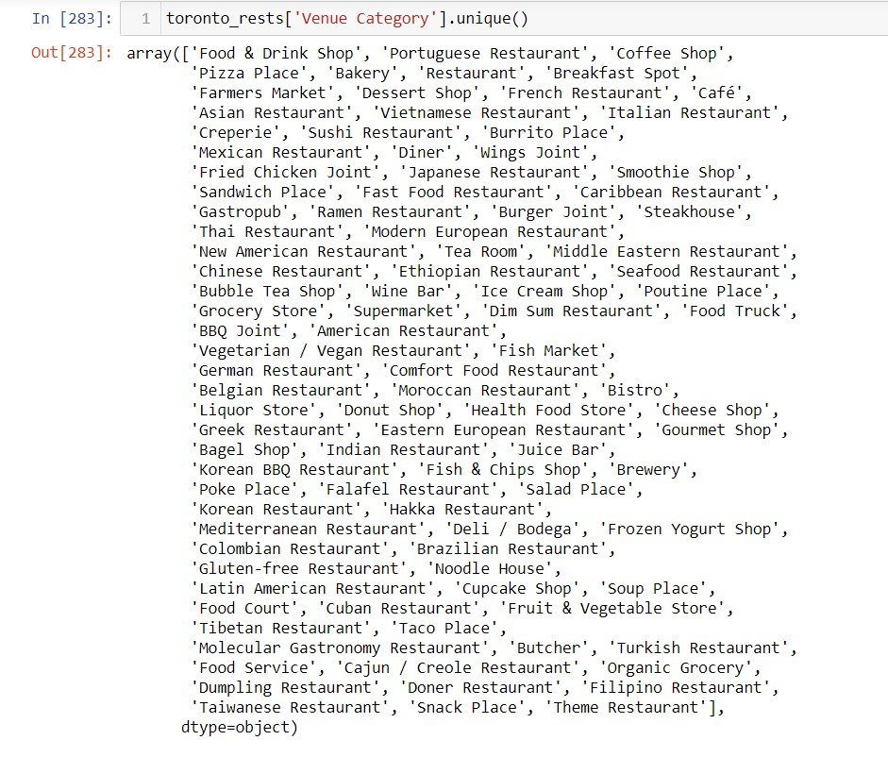
Methodology : Data Setup and Cleaning, cont.
Used the prefix string in the FourSquare Icon data to clean the data, removing all categories that did not contain the word ‘Food’.

Slide 10
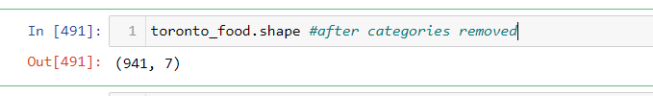
Methodology : Data Setup and Cleaning, cont.
Additional Data Cleaning:
Food venue categories removed from dataset:
Grocery Store
Restaurant (as this category was too vague for this analysis)
Food & Drink Shop
Liquor Store
Butcher
Organic Grocery
Supermarket
Coffee Shop
Dataset reduced from 2,106 to 941 venues after data cleaning

Slide 11
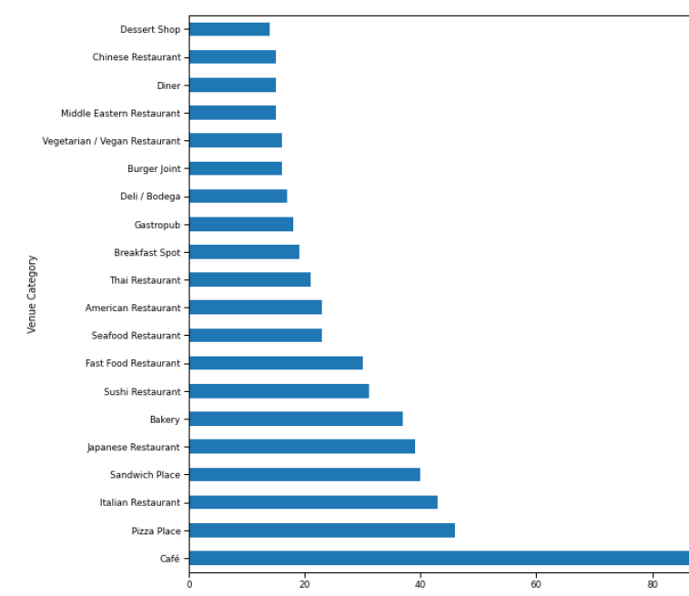
Methodology : Data Setup and Cleaning, cont.
Results of the top 20 venue categories are displayed on the graph.
Cafes, Pizza Places, and Italian Restaurants are found most often.

Slide 12
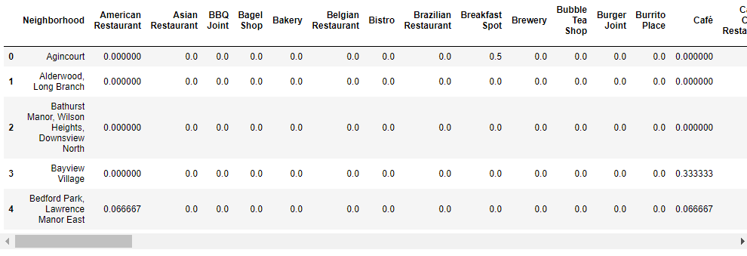
Methodology : Data Setup and Cleaning, cont.
One hot encoding was used to identify top frequented venues.

Slide 13
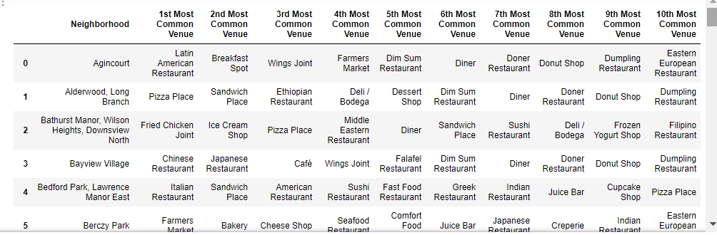
Methodology : Data Setup and Cleaning, cont.
Dataframe displays a sample of the sorted rankings of the results.

Slide 14
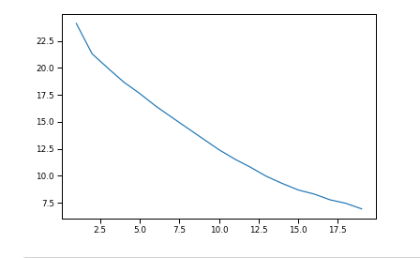
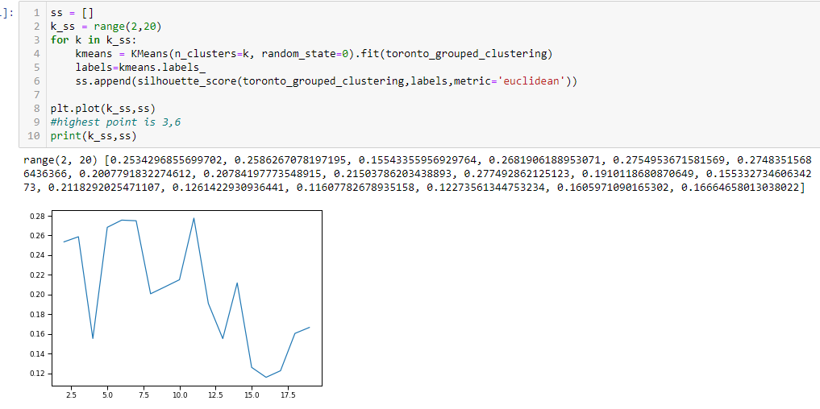
Methodology – Machine Learning
K-Means is a type of unsupervised machine learning used to identify groups or clusters in the data based on feature similarity. K-Means was used to build clusters based on the most frequented venue categories.
Attempts to find the best k included using the Elbow Method and the Silhouette Score.

Slide 15
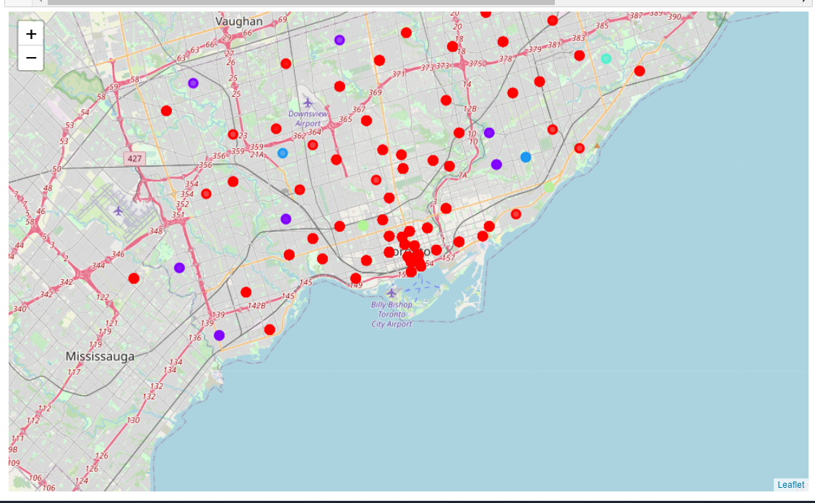
Methodology – Machine Learning cont.
Folium used to plot the 6 Clusters identified through K-Means.

Slide 16
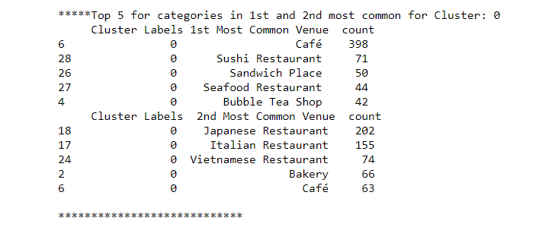
Results
Cluster 0: This cluster contains a high number of Cafes, Japanese Restaurants, and Italian Restaurants identified as first and second most common venues. This cluster could be relabeled to be identified as ‘Cafes, Japanese, and Italian’ cuisine.

Slide 17
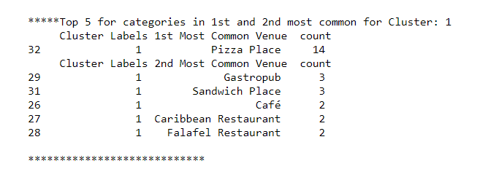
Results, cont.
Cluster 1: Pizza Places, Gastropubs, and Sandwich places were identified the strongest as first and second most common venues. This cluster could be relabeled to be identified as ‘Pizza, pub, and sandwiches’ cuisine.

Slide 18
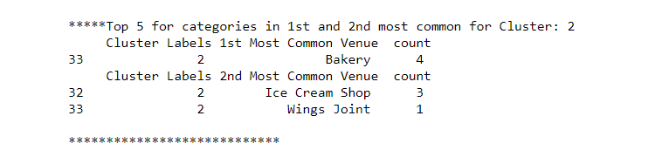
Results, cont.
Cluster 2: There were few venue categories identified in Cluster 2. The first most common venue category identified was Bakery with 4 venues and Ice Cream Shop as the second most common venue category with 3. This cluster could be relabeled as ‘Bakery and Ice Cream’.

Slide 19
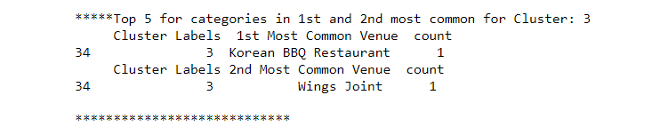
Results, cont.
Cluster 3: Cluster 3 produced one result for the first most common venue category, ‘Korean BBQ Restaurant’ and one result for the second most common as ‘Wings Joint’. This cluster could be relabeled ‘Korean BBQ and Wings’.

Slide 20
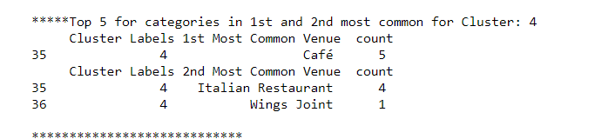
Results, cont.
Cluster 4: Few venue categories were identified in Cluster 4 with the first most common venue as Cafe with 5 venues and Italian Restaurant as the second most common venue category with 4. This cluster could be relabeled as ‘Café and Italian’.

Slide 21
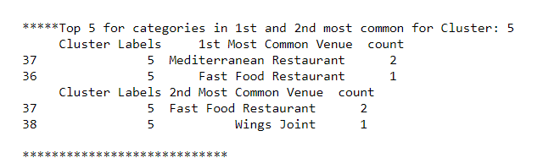
Results, cont.
Cluster 5: Few venue categories were identified in Cluster 5 with the first most common venue as Mediterranean with 2 venues and Fast Food with 1. Fast Food was also identified as a top second most common venue category with 2. This cluster could be relabeled as ‘Mediterranean and Fast Food.

Slide 22
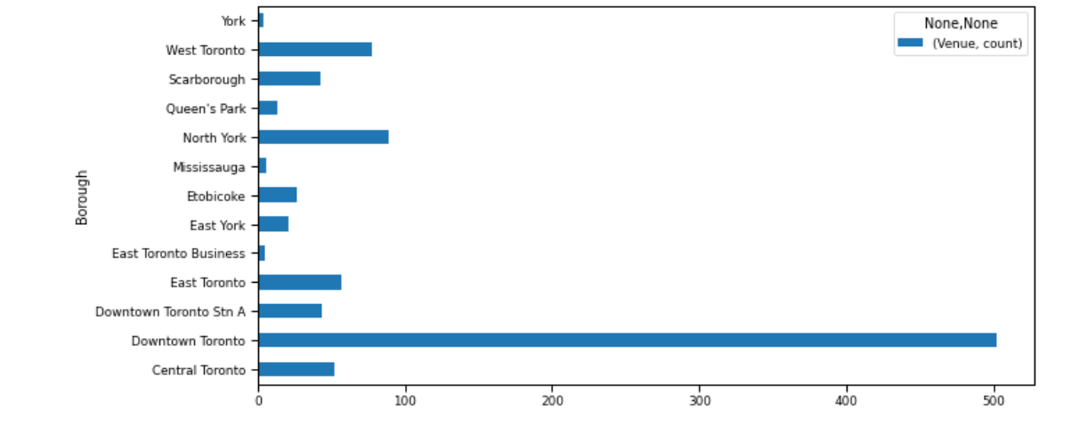
Results, cont.
The number of venues showed that the majority were located in the Downtown Toronto borough.

Slide 23
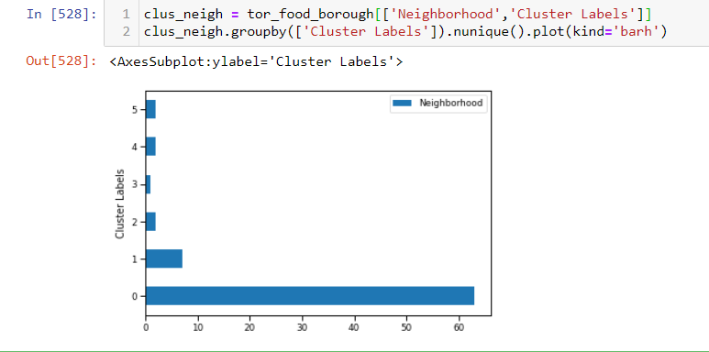
Results, cont.
The data was summarized to identify the number of neighborhoods within each cluster. Cluster 0 contained the most number of neighborhoods, which was expected after seeing the results of the cluster analysis for Cluster 0, which contained the majority of venues over any other cluster.

Slide 24
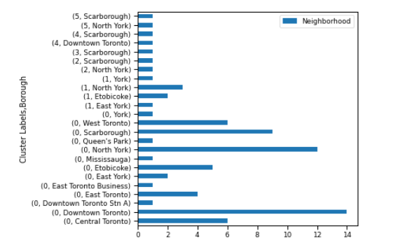
Results, cont.
This graph displays the number of neighborhoods within each cluster, borough. Downtown Toronto, North York, and Scarborough in Cluster 0 had the most number of neighborhoods assigned.

Slide 25
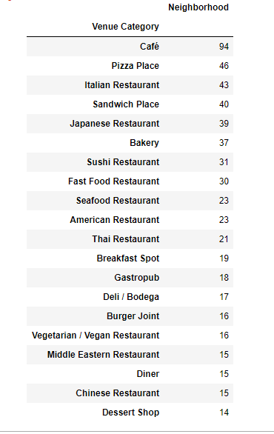
Discussion
Cafes were identified as one of the most frequented category venues, along with Pizza Places, Italian Restaurants, Sandwich Places, Japanese Restaurants, and Bakeries. This was interesting as there are very few Cafes or Japanese Restaurants in this writer’s city, which is not located in Canada.
Tourists or visitors looking for these types of venues will have many options that are highly frequented.
For those considering opening a new restaurant of one of these venue categories, further analysis would be recommended.
One could argue that these venue categories are the most successful in the Toronto area, and thus opening a new one of the same venue category could be profitable, as they are in high demand.
On the other hand, one could argue that there would be an opportunity to open a different type of venue not identified to offer consumers a new or different food category option that may not be represented as highly.

Slide 26
Conclusion
Using a clustering algorithm such as K-Means can provide an opportunity to explain, understand, and visualize a dataset and the similarity among the different data points. In this analysis, different clusters were identified based on the most frequented food venue category in the Toronto area, using the FourSquare API. With the majority of food venues occurring in the Downtown Toronto borough, it may have been helpful to either exclude this from the analysis, or to focus solely on that borough. That would be an opportunity for improvement of this study, or an opportunity for a future analysis.

